Slide 1
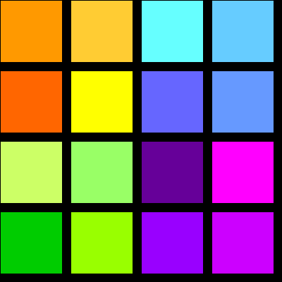
Colors

Slide 2
If we look around us, we can see many different colors.

Slide 4
blue

Slide 5
The cup is blue.

Slide 6
green

Slide 7
The leaves are green.

Slide 8
red

Slide 9
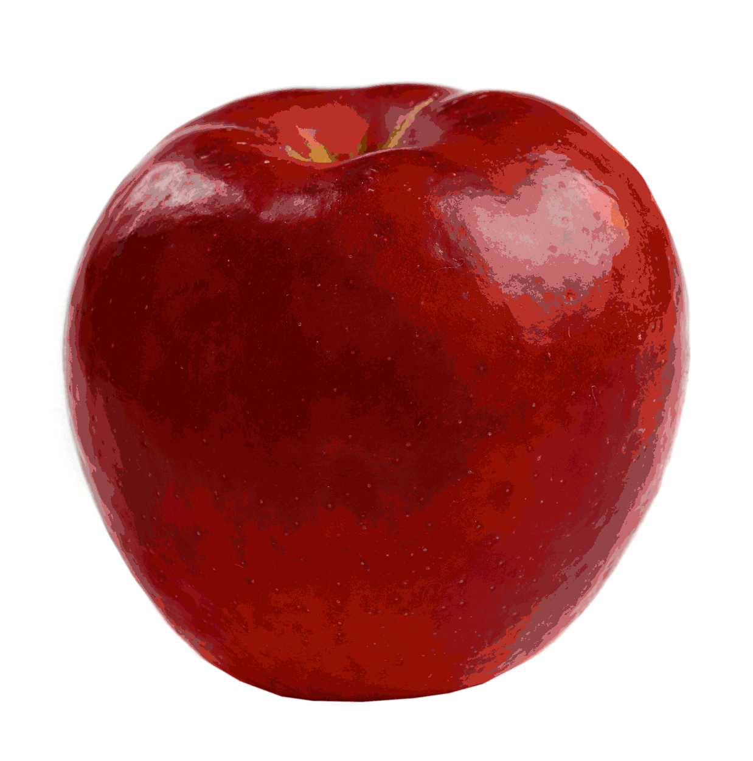
The apple is red.

Slide 10
black

Slide 11
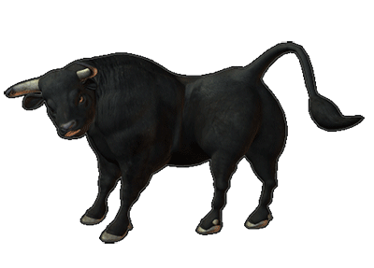
The bull is black.

Slide 12
pink

Slide 13
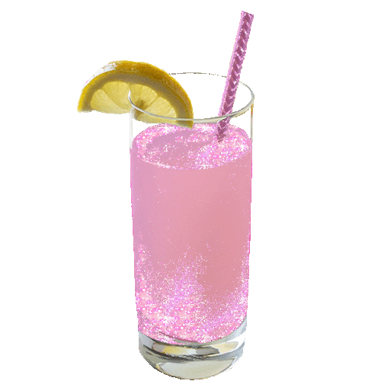
The drink is pink.

Slide 14
yellow

Slide 15
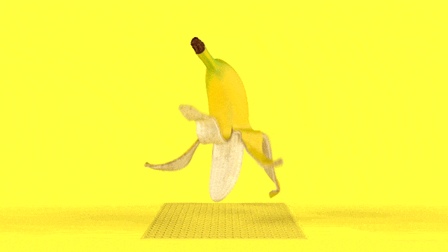
The banana is yellow.

Slide 16
white

Slide 17
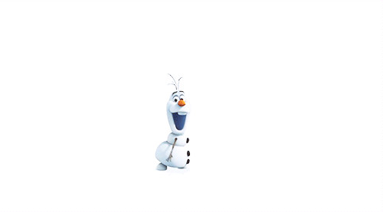
The snow man is white.

Slide 18
orange

Slide 19
The car is orange.

Slide 20
grey

Slide 21
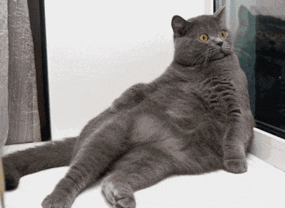
The cat is grey.

Slide 22
brown

Slide 23
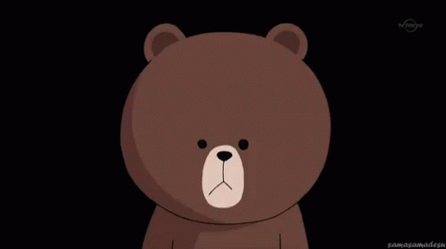
The bear is brown.

Slide 24
purple

Slide 25
The book is purple.

Slide 26
brown
purple
blue
black
white
green
pink
orange
red
yellow
grey

Slide 28
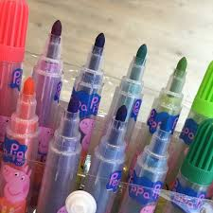
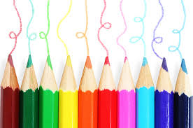
禮拜四上課帶彩色筆、色鉛筆或蠟筆

Slide 29
Look at this room.
Can you see the colors?

